Slide 1

{SecDev,Rugged,Cloud}Ops
Where Security and Operations meet

Slide 2


Slide 3
$ whoami
Blue teamer (party of one)
Done the attack stuff
Worked for one of the “big Four”
Head of Security for $company
Likes long walks on the beach

Slide 4
Agenda
AWS Accounts 101
Defend
Defend some more
Q&A
???
Profit

Slide 5
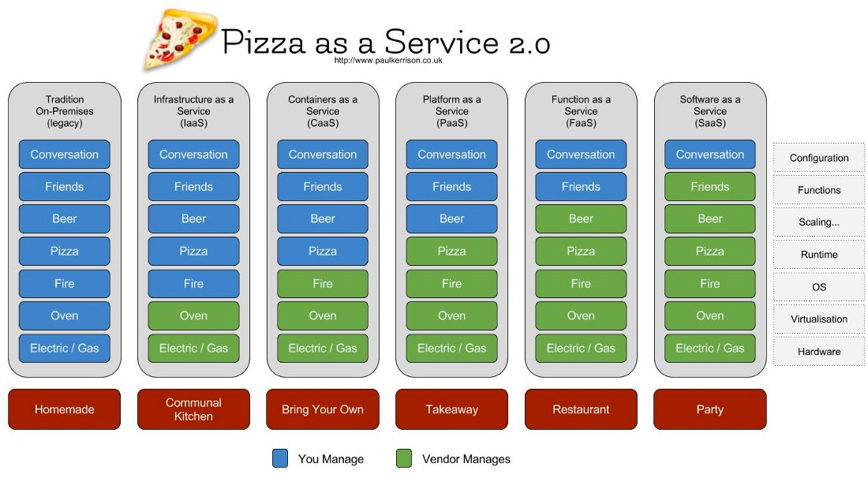

Slide 6
AWS Security 101
Protect your account
Segregate your accounts
Use “Organisations”
Use roles and minimise IAM users (access keys)
Config
Security Hub
Inspector (nothing in the UK yet)
Monitor everything (CloudTrail + CloudWatch)

Slide 7
Notes:
Account 101 Demo

Slide 8

Tooling
ScoutSuite
CloudMapper
Terraform + Packer
Python + Boto3
#brexit
Frontal Lobotomy
SecurityMonkey

Slide 9
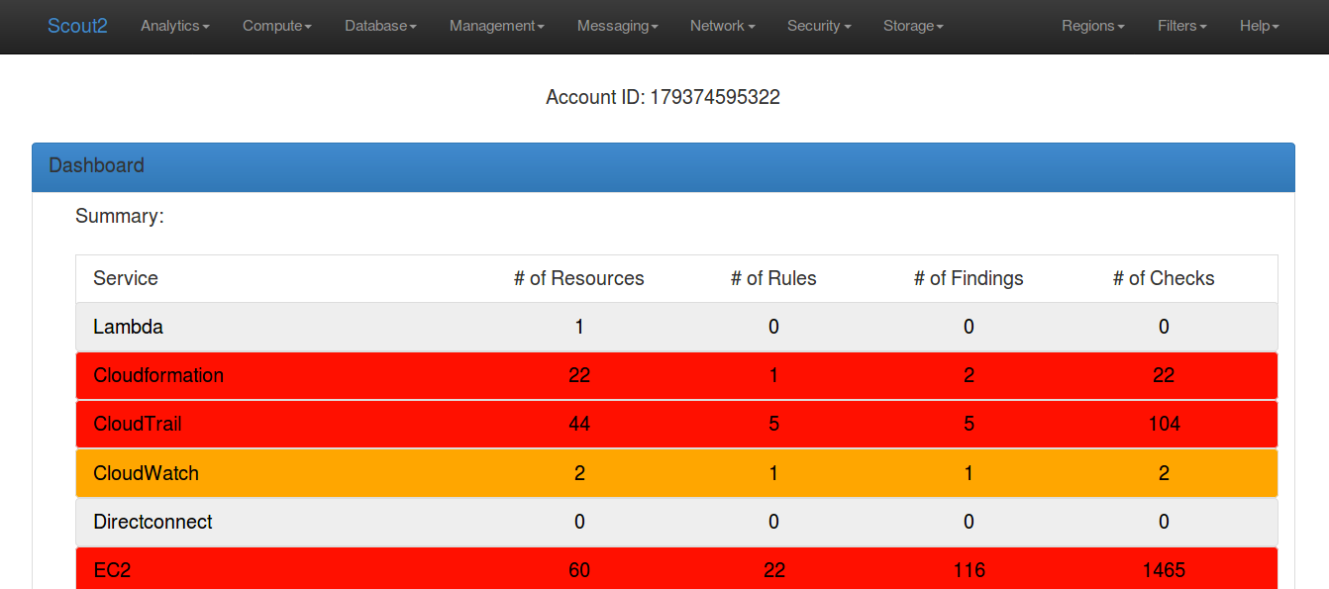
ScoutSuite https://github.com/nccgroup/ScoutSuite

Slide 10
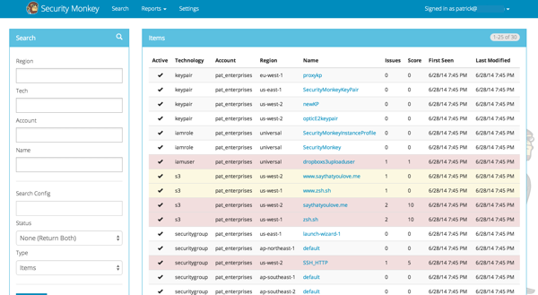
Security Monkey https://github.com/Netflix/security_monkey

Slide 11
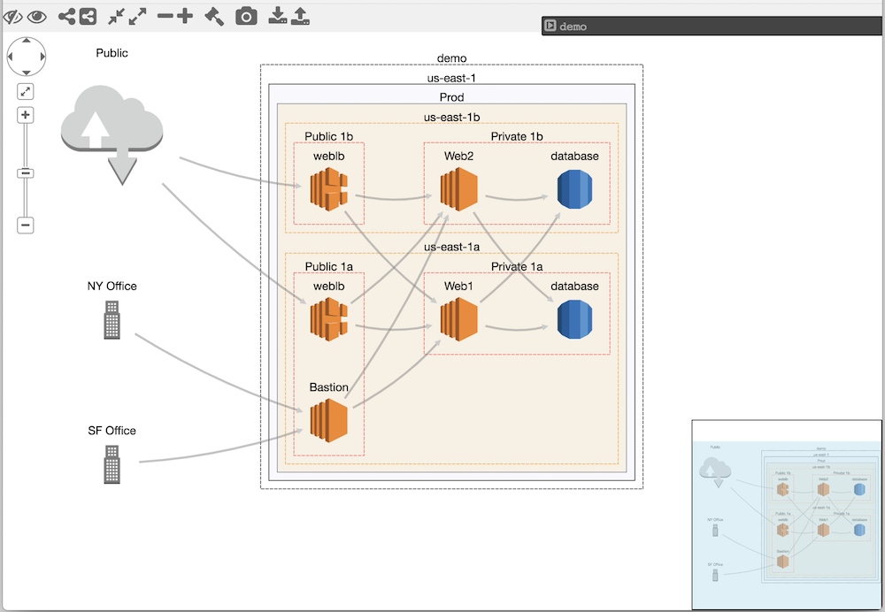
Cloudmapper https://github.com/duo-labs/cloudmapper

Slide 12

Python + Boto3

Slide 13


Slide 14
Notes:
Terraform
What it is ?
How I use it in security ?

Slide 15
AWS-InfoSec
https://github.com/znb/AWS-Information-Security-Environment

Slide 16
Defend some more
TheHive + Cortex
Google Rapid Response
MISP
Fleet + Launcher

Slide 18
Make life hard^H^H^Heasier
Git-crypt - https://github.com/AGWA/git-crypt
Aws-vault - https://github.com/99designs/aws-vault

Slide 19
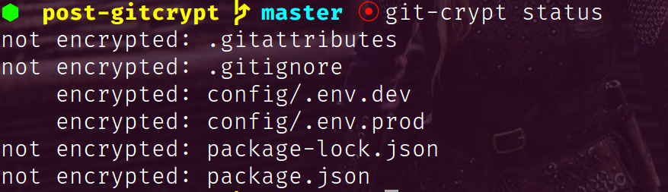
Git-crypt Demo

Slide 20


Slide 22
http://flaws.cloud/
http://flaws2.cloud/

Slide 24
https://github.com/carnal0wnage/weirdAAL

Slide 25
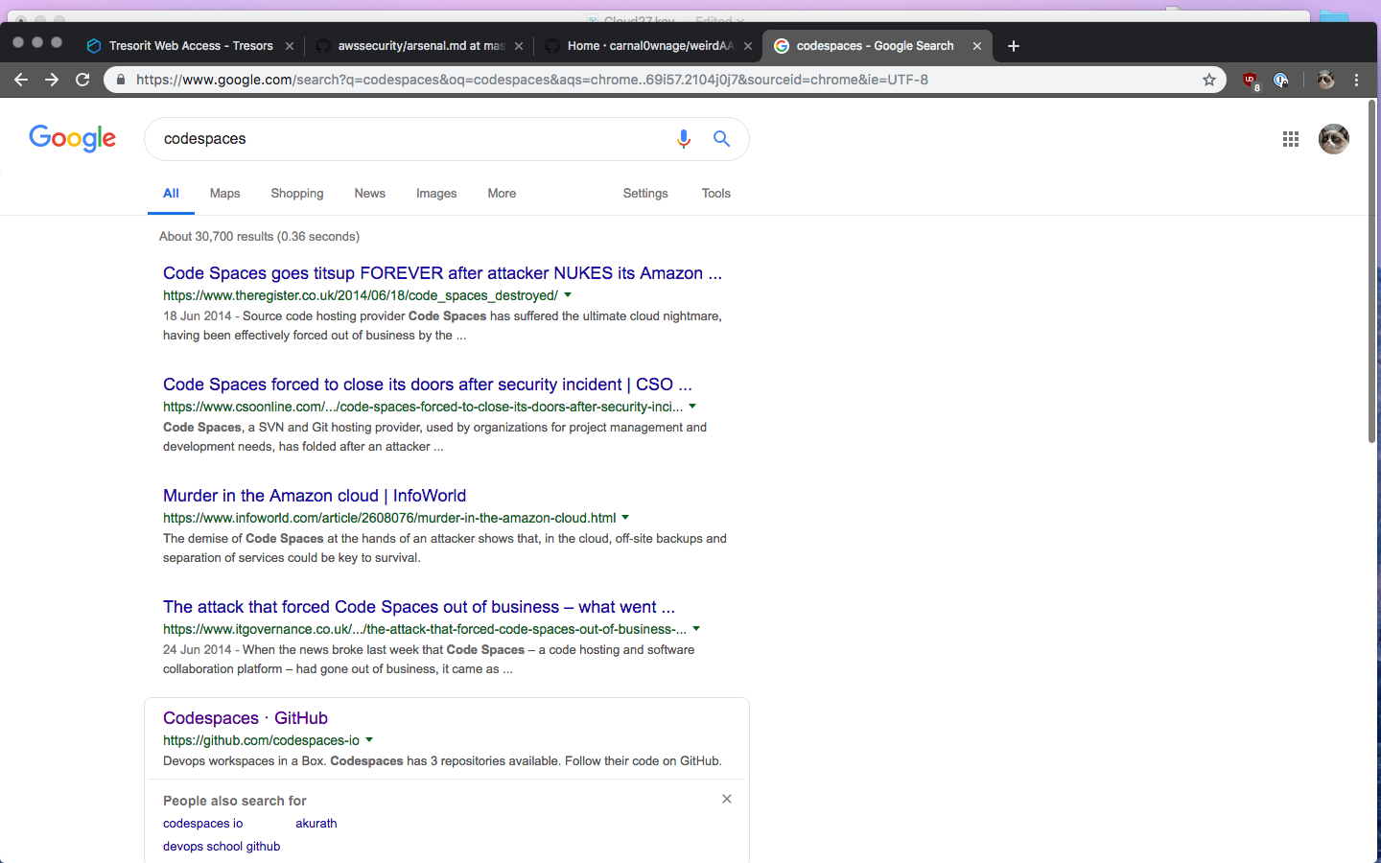

Slide 26
https://github.com/stuhirst/awssecurity

Slide 27
kthxbinowaitquestions?! https://github.com/znb/CloudPathway

Slide 28
